Slide 1
Graph Coloring
Algorithm

Slide 2
Introduction
Graph Coloring is the procedure of assignment of colors to each vertex of a graph G such that no adjacent vertexes get the same color. The objective is to minimize the number of colors while coloring a graph. The smallest number of colors required to color a graph G is called its chromatic color.

Slide 3
Applications of Graph Coloring
1) Interval Schedulings.
2) Register allocation: In compiler optimization, register allocation is the process of assigning a large number of target program variables onto a small number of CPU registers.
3) Sudoku solver: Sudoku is also a variation of Graph coloring problem where every cell represents a vertex. There is an edge between two vertices if they are in same row or same column or same block.

Slide 4
Algorithms Used
The following Algorithms are used in the implementation: 1) Greedy Algorithm with and without randomness 2) Wigderson's Algorithm using BFS and DFS with and without randomness 3) BackTracking with and without randomness 4) Randomized Graph Coloring

Slide 5
Greedy Algorithm
The greedy algorithm considers the vertices one by one and uses the first available color. It doesn’t guarantee to use minimum colors, but it guarantees an upper bound on the number of colors. The basic algorithm never uses more than d+1 colors where d is the maximum degree of a vertex in the given graph [2]. The following is the basic idea of it:-

Slide 6
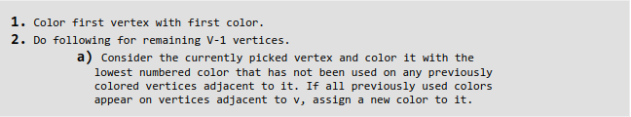

Slide 7
Backtracking Algorithm.
In backtracking graph coloring algorithm, we iterate over all the vertices in an order, then for each vertex v in V, we assign minimum available color for it, if we can assign the color, then we color the next vertex in the same way, if we ran out of colors then we give the previous vertex a different color so that we can color the new vertex. A recursive algorithm is given below:

Slide 8
ALGORITHM isSafe(k,c)
//input:The node to be colored k,the color c
//output:true or false
//function: To check whether the given sent color is safe for the node
1.for i->1 to n //number of nodes
if g[k,i]=1 and c=x[i]
return false
else
goto step 2
2.return true

Slide 9
ALGORITHM graphColor(k)
//input:The node to be colored
//output:The given color
//function: To find the the appropriate color
for c->1 to m //number of colors
if isSafe(k,c)
x[k]<-c
print k-->x[k]
return

Slide 10
Example
1
2
4
3
If d is the degree of a given graph then it can be colored using d+1 colors

Slide 11
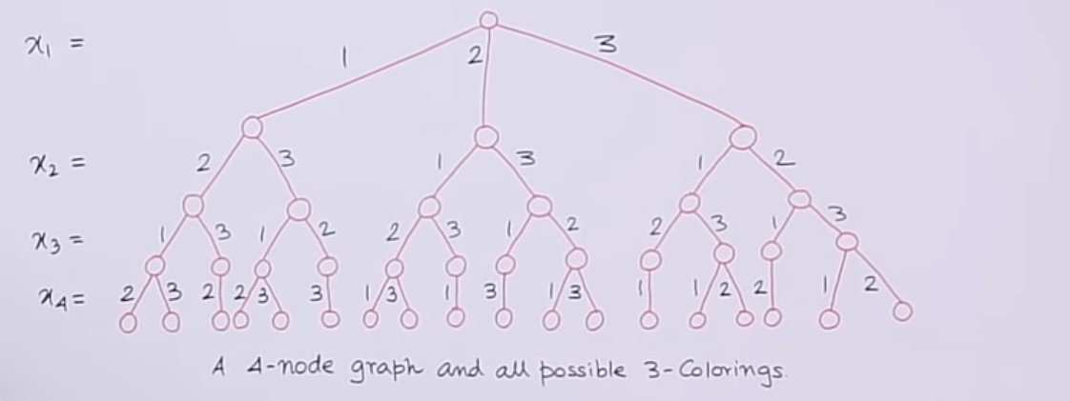
Solution

Slide 12
ThankYou

